Slide 1

Binary Filtering and Analysis:
An Overview of the Tools and Processes that Provide Pivotal Reverse Engineering Information
By Austin Peterson and Ethan Benkel

Slide 2

Introduction/ Purpose
What are binary filters used for?
What are the processes of some binary filters?
What RE tools utilize binary filters and how do they work?
Which of these tools is superior to others?

Slide 3
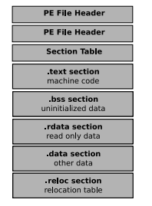
Binary Filters
Perform extraction of vital code attributes
Help us understand the functionality, control flow and threat level of a given executable
Often vital to combating anti-reversing techniques (code obfuscation)
Can be static or dynamic in nature

Slide 4
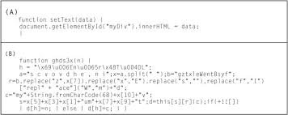
Binary Filters and Code Obfuscation
Obfuscated code is a pertinent real world issue
Code is obfuscated to provide security and decrease readability of code
Comes in the form of overlapping instructions and opaque predicates
We can combat obfuscation with a special binary filter known as a deobfuscator

Slide 5
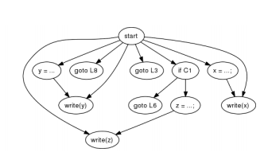
Deobfuscator Layout
Main goal is to extract a minimalist control flow diagram
Based mostly on statistical observation rather than an advanced algorithm
Step 1: Form nodes
Step 2: Source and destination nodes are connected
Step 3: Remove instruction conflicts
Step 4: Randomly eliminate existing conflicts
Note: This algorithm is still in development

Slide 6

Malware Detection with Binary Filters
Malware hides itself in many nefarious ways
(Multiple NOP insertion, instruction rearranging/ substitution, instruction weaving/ concurrent execution)
Binary filters can locate and extract malicious code sequences in an executable

Slide 7

Malware Detection with Binary Filters
We can layout a binary filter to detect/ extract malware after disassembly and annotation of code
Step 1: Construct a malicious code assembly automation for a given virus
Step 2: Convert this automation to a higher level abstraction
Step 3: Compare paths of target program’s control flow to the malicious code automation
Step 4: If a path of control flow resembles the automation, the virus can be detected

Slide 8
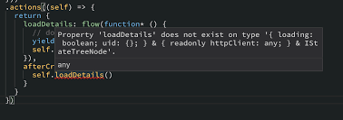
Type-State Analysis with Binary Filters
Reading machine code for variable and function conditions
Helps layout the rules of the program, easier to determine program functionality and assess security
Important terms are type-state, access policy and invocation

Slide 9
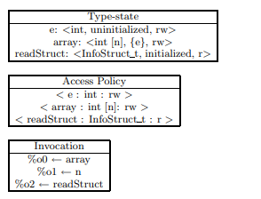
Stages of Type-State Analysis on Machine Code
Stage 1: Consolidation of information
Stage 2: Type-state propagation
Stage 3: Annotation
Stage 4: Local and global verification

Slide 10
Final Thoughts on Binary Filtering Processes
Play a pivotal role but are mostly used to solve theoretical problems
Issues with scalability and difficult implementation
Potential to become obsolete with increased complexity of malware and cyber-attacks

Slide 11
Methods and Tools

Slide 12




Binary Filtering Methods and Tools
Binary filtering and analysis is considered to be a recent and developing field of research
Analyzing binary files can reveal a plethora of practical challenges
A variety of tools, such as IDA Pro and Ghidra, have been developed to overcome common obstacles

Slide 13

BINCOA: Simple Analysis
Binary Code Analysis (BINCOA) is a framework and filtering implementation designed to ease development of binary filters and analyzers
Constructed around the Dynamic Bitvector Automata (DBA)
Provides three major filtering and analysis functions that WORK TOGETHER
Test data generation
Control flow diagram recovery
Code simulation
Note: Small scale and still in development

Slide 14

BitBlaze Platform
Broad spectrum platform capable of static and dynamic analysis as well as symbolic exploration
Static: Vine
Control flow graphs
Control and data dependency graphs
Dataflow analysis
Dynamic: TEMU
Emulates an entire system, including full OS
Allows binary execution observation at a very fine level

Slide 15
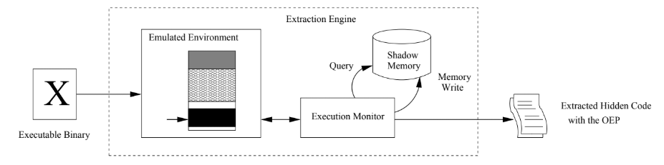
Renovo: Hidden Code Extraction
Dynamic analysis method built on BitBlaze’s TEMU component
Utilizes an execution monitor and shadow memory space
Checks for overwritten memory regions, or “dirty” regions
Extracts hidden code with entry point
Capable of detecting multiple levels of hidden code

Slide 16
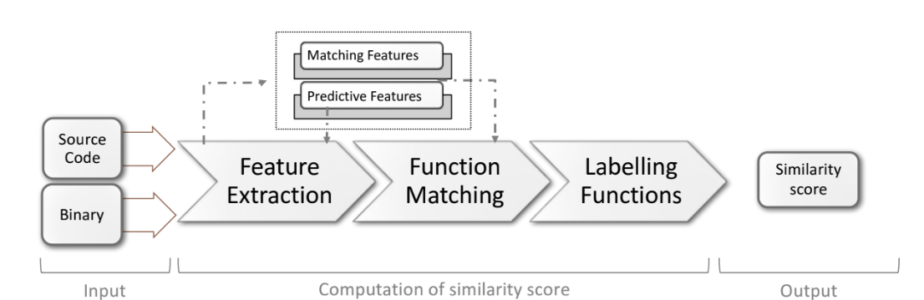
BinPro: Code Similarity
Statically analyzes source code and compiled binary files
Extracts features and function call graph from both source code and compiled binary files
Matches features using a bipartite matching algorithm
Labels and weighs bipartite graph nodes as “matched”, “unmatched” and “multimatched”
Produces a similarity score based on percentage of “matched” nodes and edge weights

Slide 17
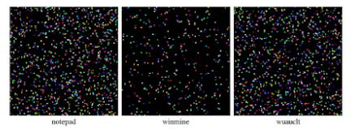
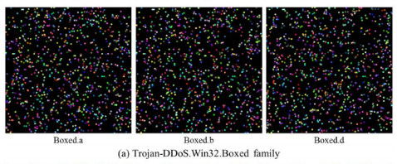
Malware Visualization
Static analysis method
Effective tool for classifying malware families
Divides disassembled binary into sets of opcode instructions
Each sequenced is a assigned a coordinate and an RGB code, produced by 2 hash functions (SimHash and djb2)
Analyzing the similarity of the resulting image can determine malware family

Slide 18
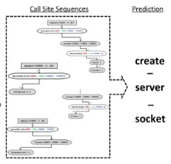
Nero: Analyzing Stripped Binaries
Static analysis method
Provides platform for analyzing binaries with low-syntactical information and no debugging symbols
Reconstructing function call sites and analyzing argument history results in a control flow graph with labeled arguments
By symbolically exploring the CFG the platform can produce a set of potential function call sequences
Nero’s trained AI can analyze this set of sequences to produce a function name with a high level of accuracy

Slide 19
In Conclusion
Binary filters are vital to understanding and contextualizing binary files
They allow us to combat common anti-reversing techniques found in malware and other types of software
A wide variety of tools exist to overcome different challenges
Filtering and analysis is a developing field of computer science and will continue to grow

